Slide 1




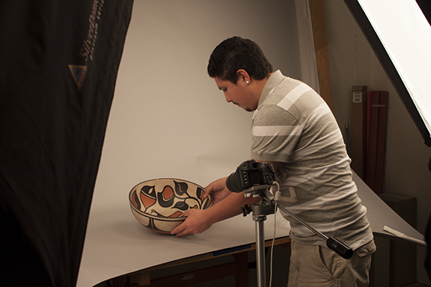
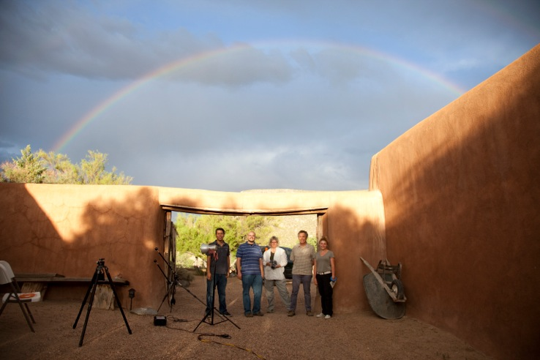
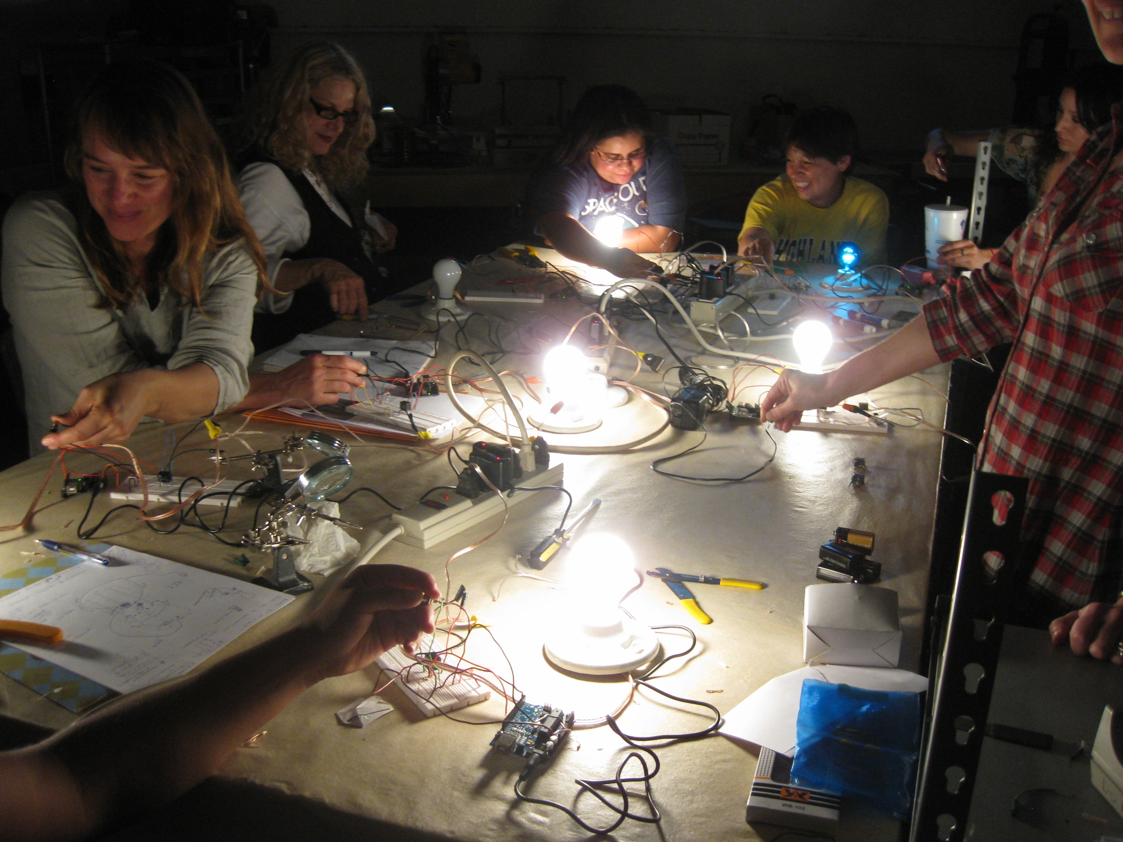
SITE Supervisor training
+
=
“Enriching community through technology, one museum at a time.”

Slide 2
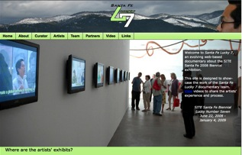


NMHU | DCA Internship program
Usually 100 hours
Project driven | cultural institution, museum or library
Skill set approved by faculty advisor and Mimi, Miriam and Lauren
Stipend is about $15.00 per hour
Payment schedule set up individually per project length.
Usually $750.00 at the start and $750.00 when the project is completed.
Notes:
Details about DCA internships

Slide 3
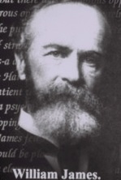
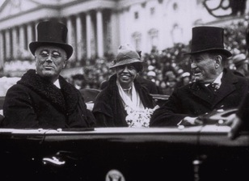
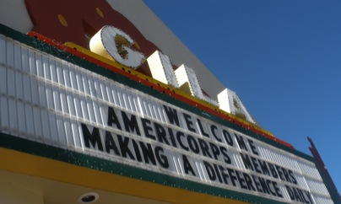
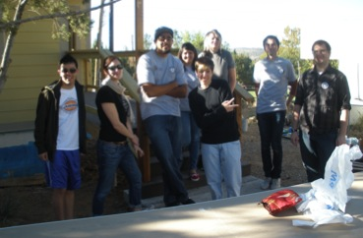
AmeriCorps:
The History of
National
Service
President Clinton signs the National and Community Service Trust Act of 1993, creating AmeriCorps and the Corporation for National Service.
Mission: Improve lives, strengthen communities, and foster civic engagement through service and volunteering
Notes:
Clinton is intrigues by the national service movement and During the Clinton Campaign in 1991“A domestic GI Bill that would ask young Americans to go to the streets of our cities and be teachers, to be policemen where we need community policemen, to be nurses where there’s a nursing shortage, to be family service workers where families are breaking down and children are abused and neglected, to rebuild America from the people point of view. We can do this with a national service.”

Slide 4
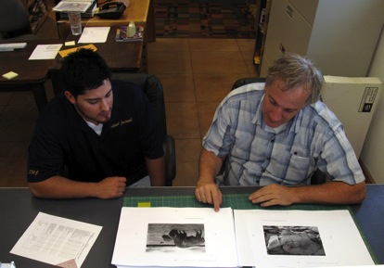
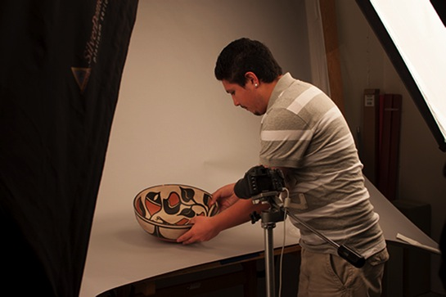
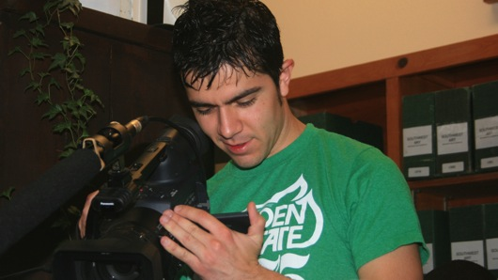
Types of Internships
DCA Internships
  Project driven | term defined by individual project
AmeriCorps Internships
  Minimum time- summer
  Half Time- during the semester only if you are taking one or two classes.
  Full time- after graduation
Notes:
Stories from the land, workshops with Artist/writers in Residence at NM State Monuments (Jemez Natn’l Monument)
YMP– GOC, MOIFA working with youth and documenting world AIDS day, global leadership forum working with UWC
Web App – To give additional information about Historic Buildings in Santa Fe.
Possibly working under Doug’s supervision to create a virtual exhibit of the 14,000 Years exhibit at NMMoA.
Possible internship designing front ends for two database-driven websites, one for OAS and one for the History Library, paid for by us. Could be one internship.

Slide 5
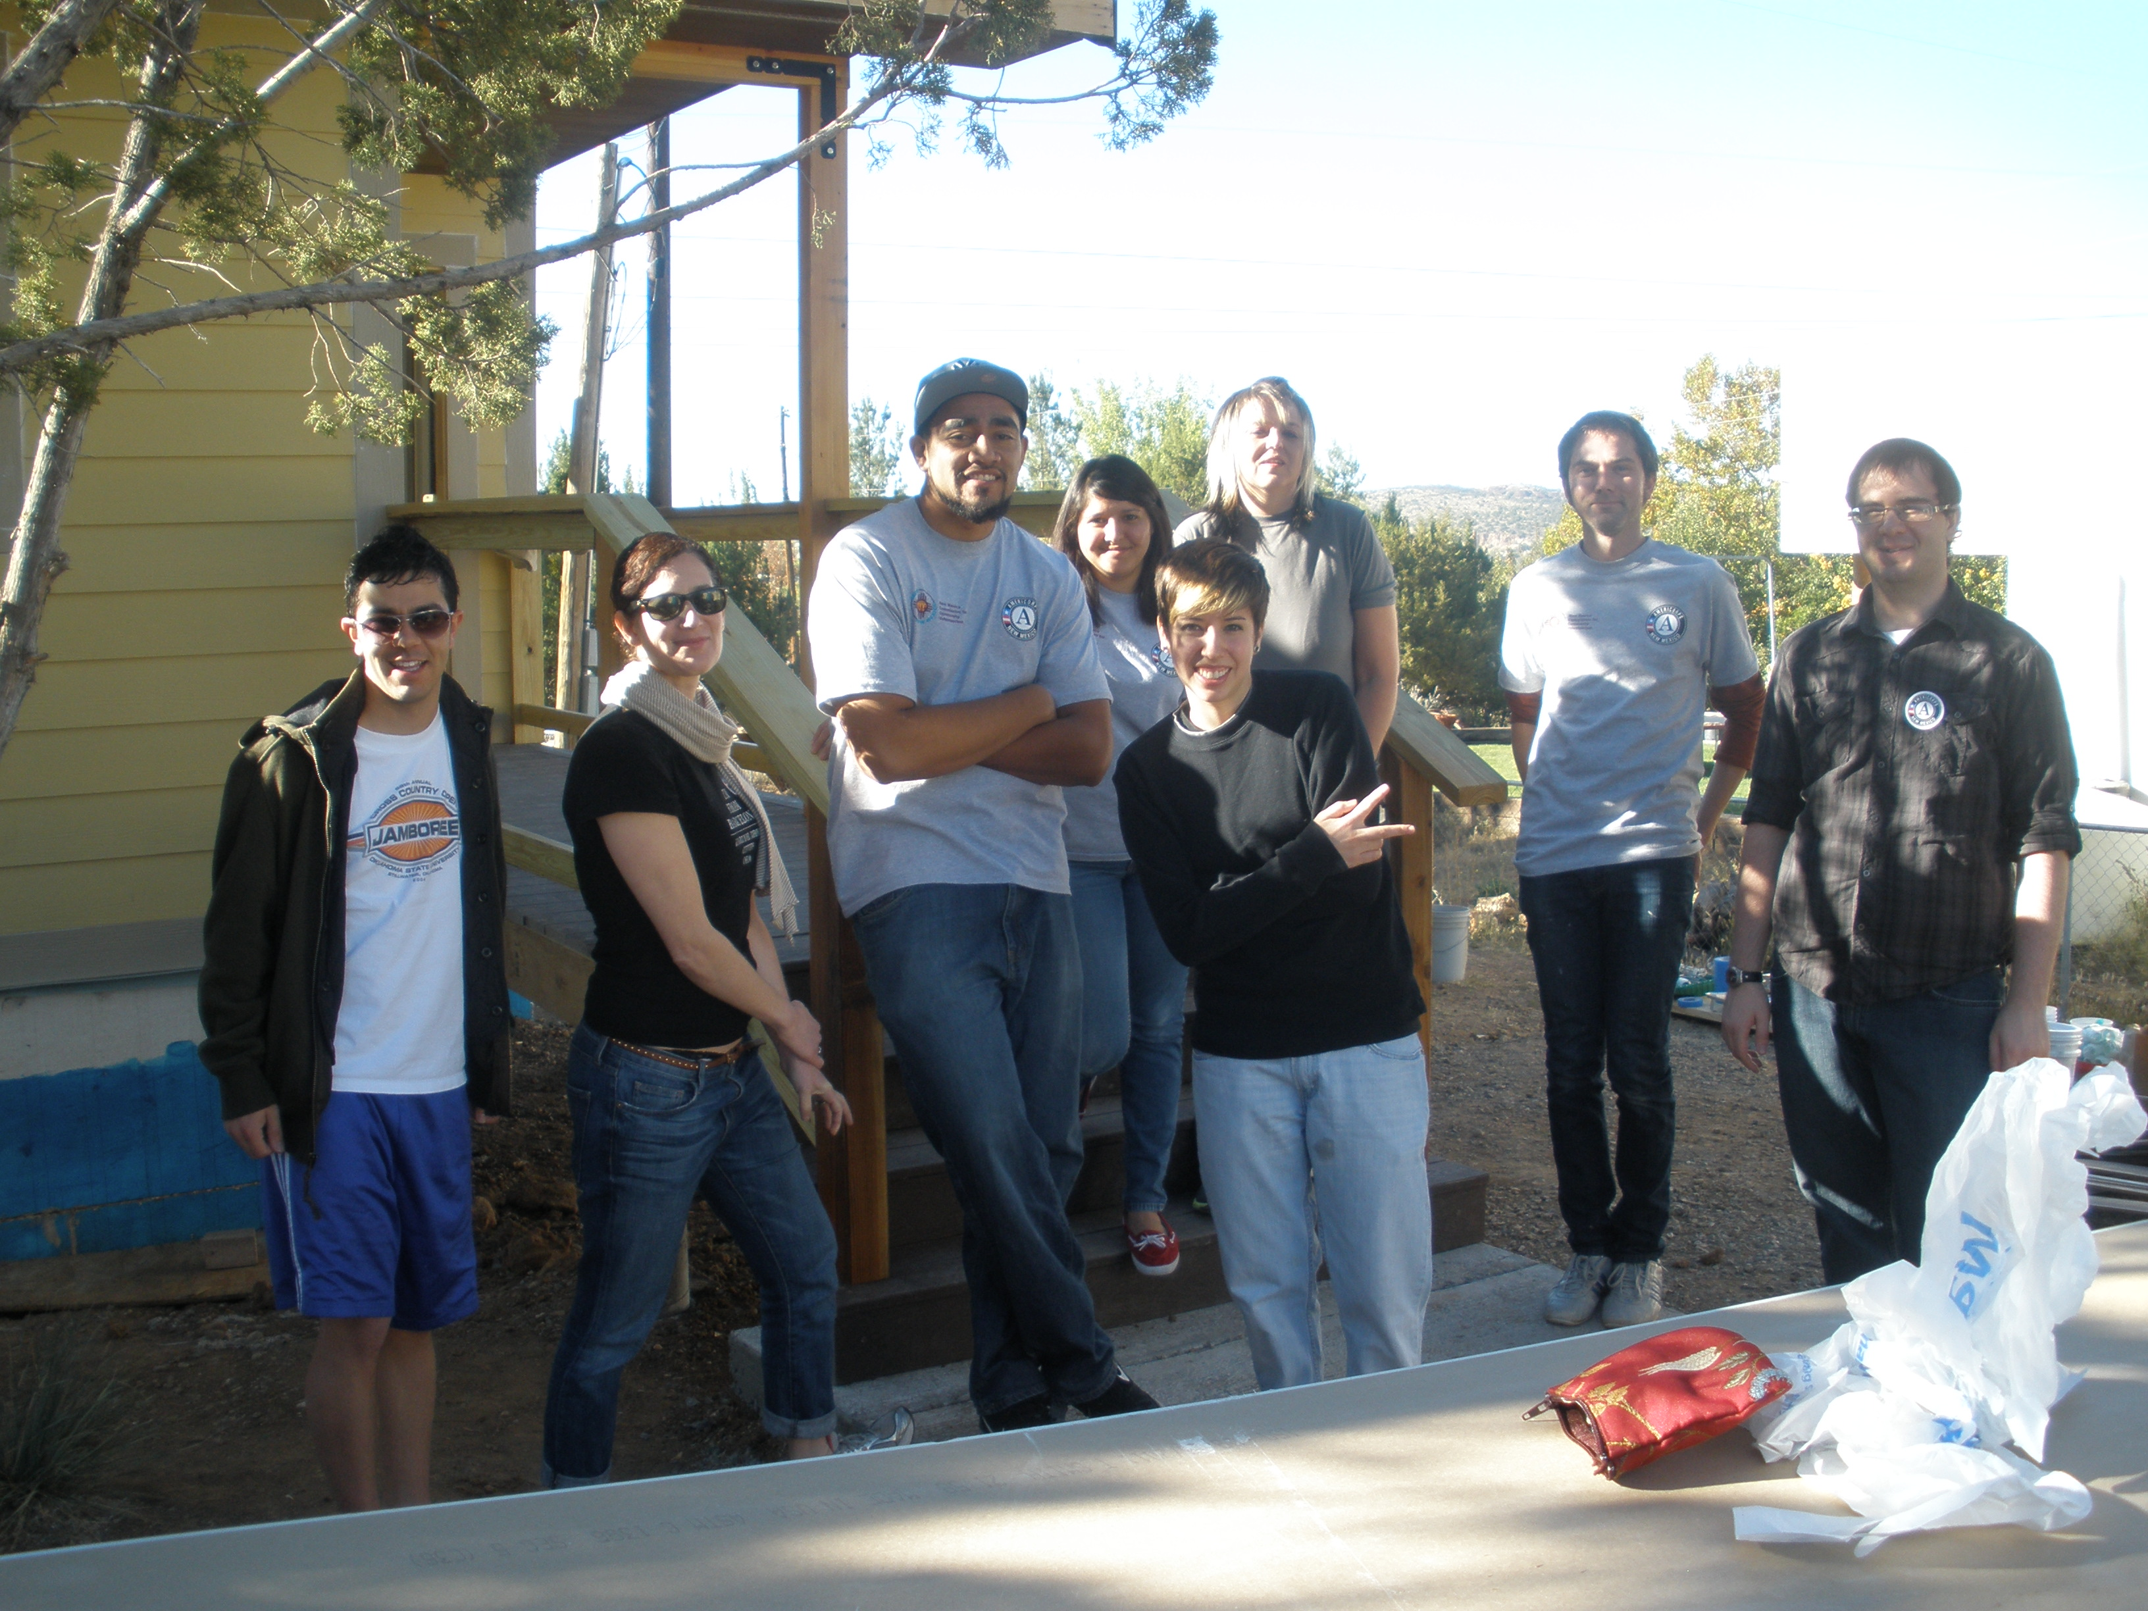
A few host sites
2010
Museum of New Mexico Press
New Mexico Museum of Natural History and Science
Museum of Indian Arts and Culture
National Hispanic Cultural Center
Bradbury Science Museum
2011
City of Las Vegas Museum
Citizen’s Committee for Historic Preservation
SITE Santa Fe
NRAO- VLA
Rancho de las Golondrinas
Balboa Park Online Collaborative
Museum of Spanish Colonial Art
NM Tourism Department
Roswell Museum and Art Center
Santa Fe Institute
Santa Fe Children’s Museum
Albuquerque Museum of Art and History
Office of Archeological Studies
2012
The Georgia O’Keeffe Museum
Luna Community College
Office of Digital Initiatives
Youth Media Project
ISEA
NM Museum of Space History

Slide 6


How do I prepare for my internship in
Cultural Technology?
Competency in at least one of the following:
  Web Development, Photo, Video, Interactivity, Graphic Design/Web Design
  Applied for/completed
  a Seabury Fellowship
  Completed PICT and or Exhibition Design

Slide 7

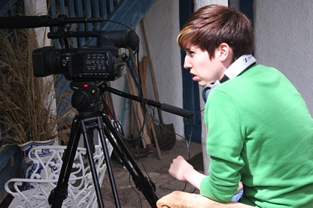
Sequencing your internship opportunities
Start out with a DCA internship fill out this form!
Then apply for a summer AmeriCorps placement
Then, a full or half time position after you graduate
Term limits on ACT internships

Slide 8
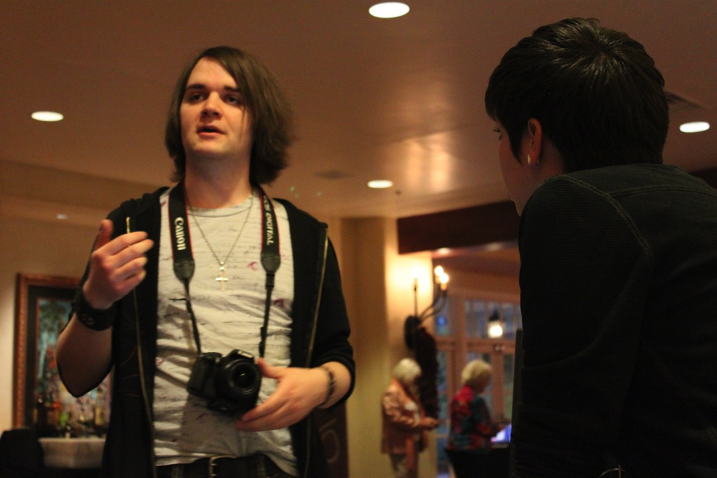
Requirements for an AmeriCorps placement
If you are a NMHU Media Arts Major you need to be within 12 credit hours or less to graduate.
Good academic standing
A United States citizen, United States National or lawful permanent resident of the United States and at least 17 years of age.
Provide the following documents prior to enrollment:
  1) Copy of birth certificate and social security card OR passport
  2) Drivers license or NM ID.
  3) proof that you have initiated the FBI background check and bring in your NM state background check.
Commitment to service for a full-time position, part-time or minimum time position. Commitment to enrolling in the Cultural Technology class and AmeriCorps service activities and trainings.

Slide 9
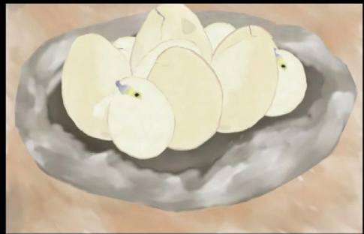
Timeline for 2013-2014 summer
April 1- May 1 Accepting applications for ACT positions. Accepting proposals for DCA internships.
May 1- May15 Interview and selection process
May 15 Notification of ACT and DCA placements
May 15-24 Eligibility Documents for ACT
May 24 Orientation and Enrollment ACT
June 3- July 8 CTM Class on Tuesdays 1- 3pm
August 31 End of ACT term.
***Note: For DCA internships, you must be enrolled full time. If you’ve graduated, you’ll need to invoice as an independent contractor.
For ACT, if you’ve graduated, you’ll have to fill out a non-degree seeking application $25.00 and enroll in and pay for the Cultural Technology Mentorship Class for one credit hour.
You cannot hold a work study or a GA position while you’re enrolled in ACT. Mary will work with you and HR, but you’ll need to plan accordingly.

Slide 10
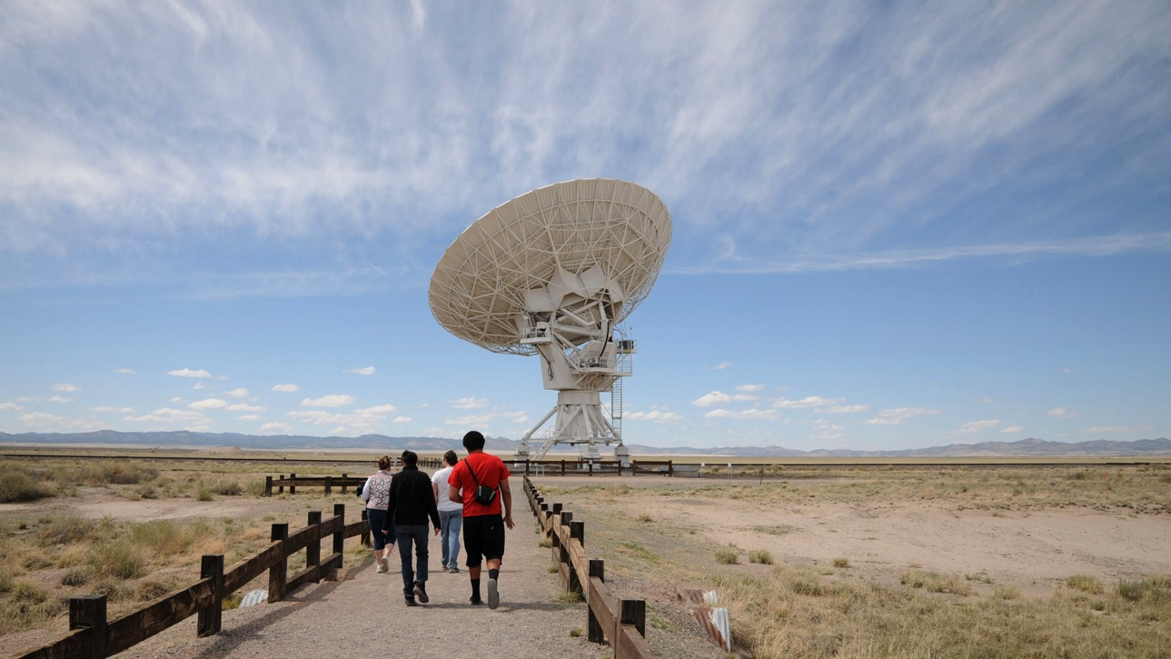
AmeriCorps Living Allowance and Benefits
Full time - 1700 hours
Part time - 900 hours
Minimum time- 300 hours
Living allowance of $19,500.00 for full time +
Segal Education Award of
$5,550.00
AND health insurance!
Living allowance of $9750.00 for part time +
Segal Education Award of
$2,775.00
Living allowance of $3,250.00 for minimum time +
Segal Education Award of $1,132.00

Slide 11

What’s on the application?
Sample application

Slide 12
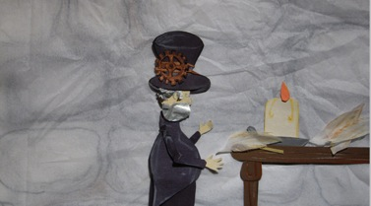
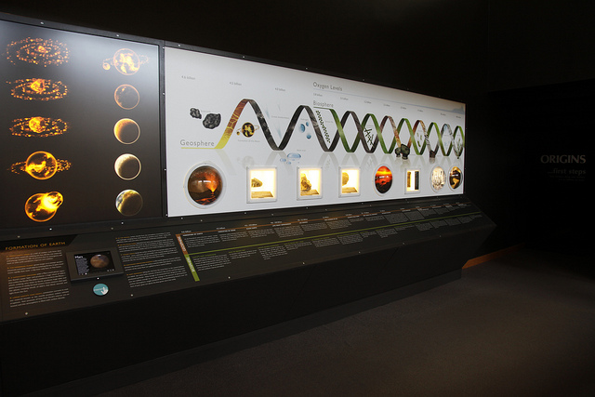



Portfolios
Johnny Alvarez
Rianne Trujillo
Veronica Black
Mike Jackson
Jason Valdez

Slide 13
Apply online
Go to https://my.americorps.gov/mp/login.do
Click on Apply to serve
Create a profile (steps 1-4) make sure you indicate that you will accept emails from this system
You will receive an email from recruitment, follow the link and create a username and password
Login to your account to complete the application
Select create application and complete steps 1-8
After you have created your application, search listings and apply to the service opportunity that best suits you. You can apply for more than one service opportunity
Remember to follow these instructions step by step

Slide 14
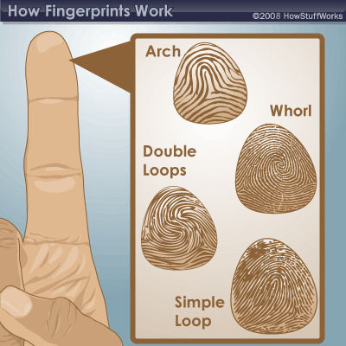
Before you begin your service:
You must have an FBI and state background check
Please start this process ASAP, send me the paperwork along with any receipts (signed by you) and if you are selected and enrolled, the program will reimburse you for your expenses.
You cannot begin serving until your FBI check is complete and I have the results.

Slide 15
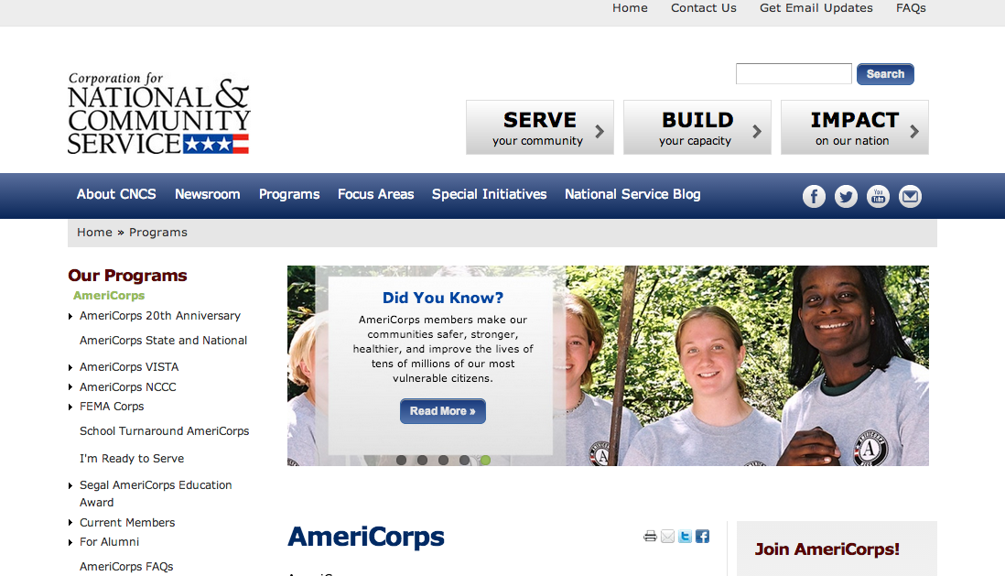
You can keep up with what’s available too!
Go to the AmeriCorps website
Select Technology and NM
Notes:
6 slots -- SITE SF, OO, CCHP, NMNHM&S, Roswell, O’Keeffe,

Slide 16

Contact Information and website
Center for Cultural Technology

Slide 17

Questions?

